Slide 1

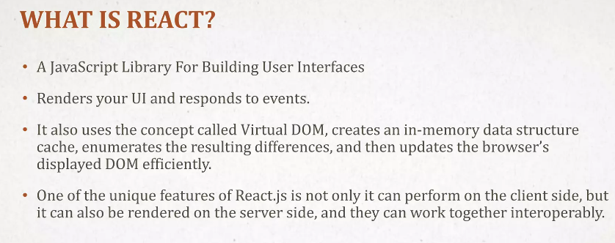
ONLINE MARKET PLACE(OLX)
Name- Sachin Kumar
Roll No.- 2010991392
Batch - G22

Slide 2
This is a header section. All the changes has been done in header.js file. I had created div with className = “headerParentDiv” in which I had created another div with className = “headerChildDiv” in which again I had created another div with className = “brandName” and insert logo in it. In the next div I had inserted searchbar and in the next div with className = “loginPage” I had insert login button and in the last div I had inserted sell button with className = “sellMenu”.

Slide 3
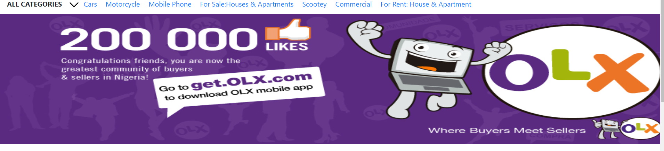
I have created another div in banner.js file in which I have created className = “bannerParentDiv” in which I have a created a another div with className = “bannerChildDIv” and another div with className = “Menubar” and in next div I have created and another div with className = “otherQuickOption” in which I have created span and giving link to it so that we can have open different page for different products and after this I have created another div with className = “banner” in which I have inserted img.

Slide 4
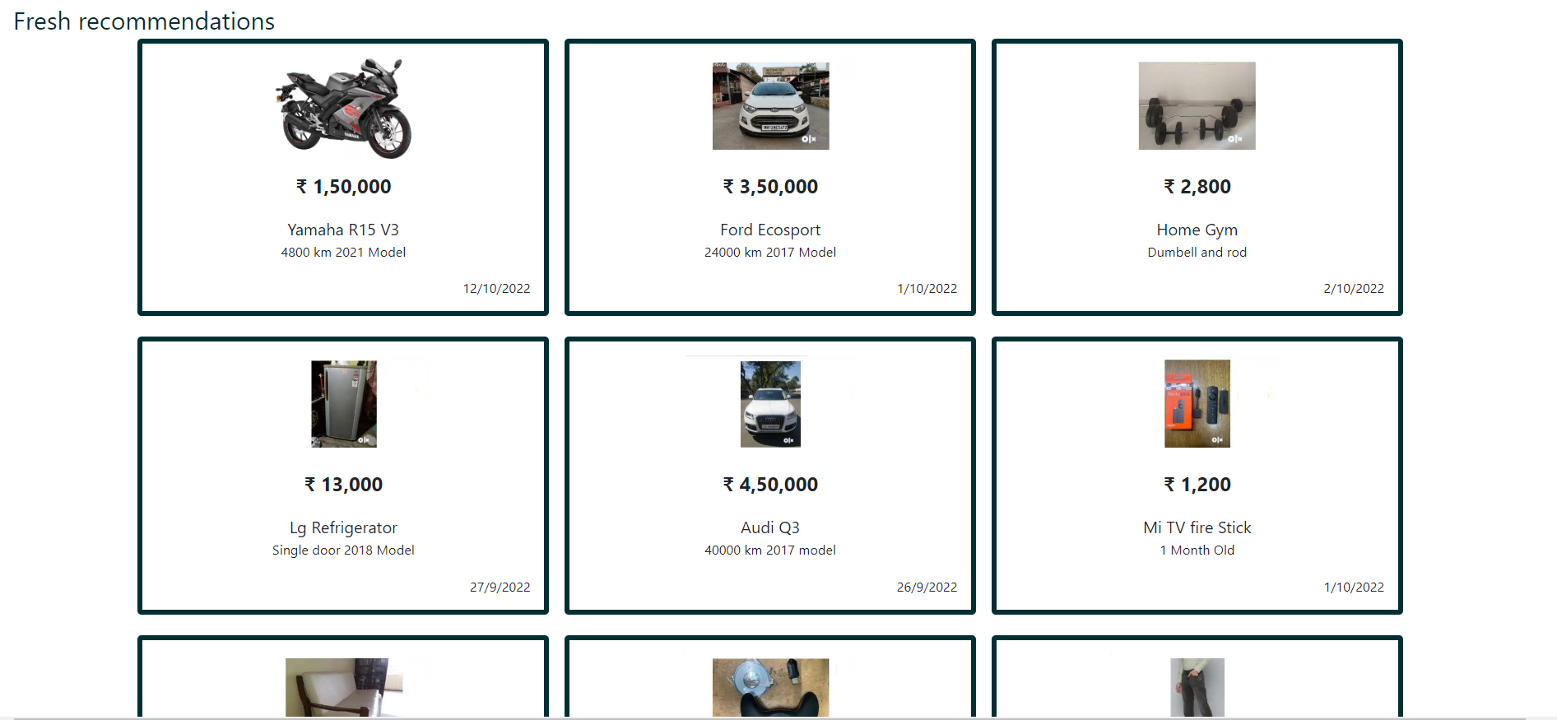
It is a post.js file in which I have posted all the products in it. First of All I have created a div with className = “postParentDiv” in which I have created numbers of div to put products in different div.

Slide 5
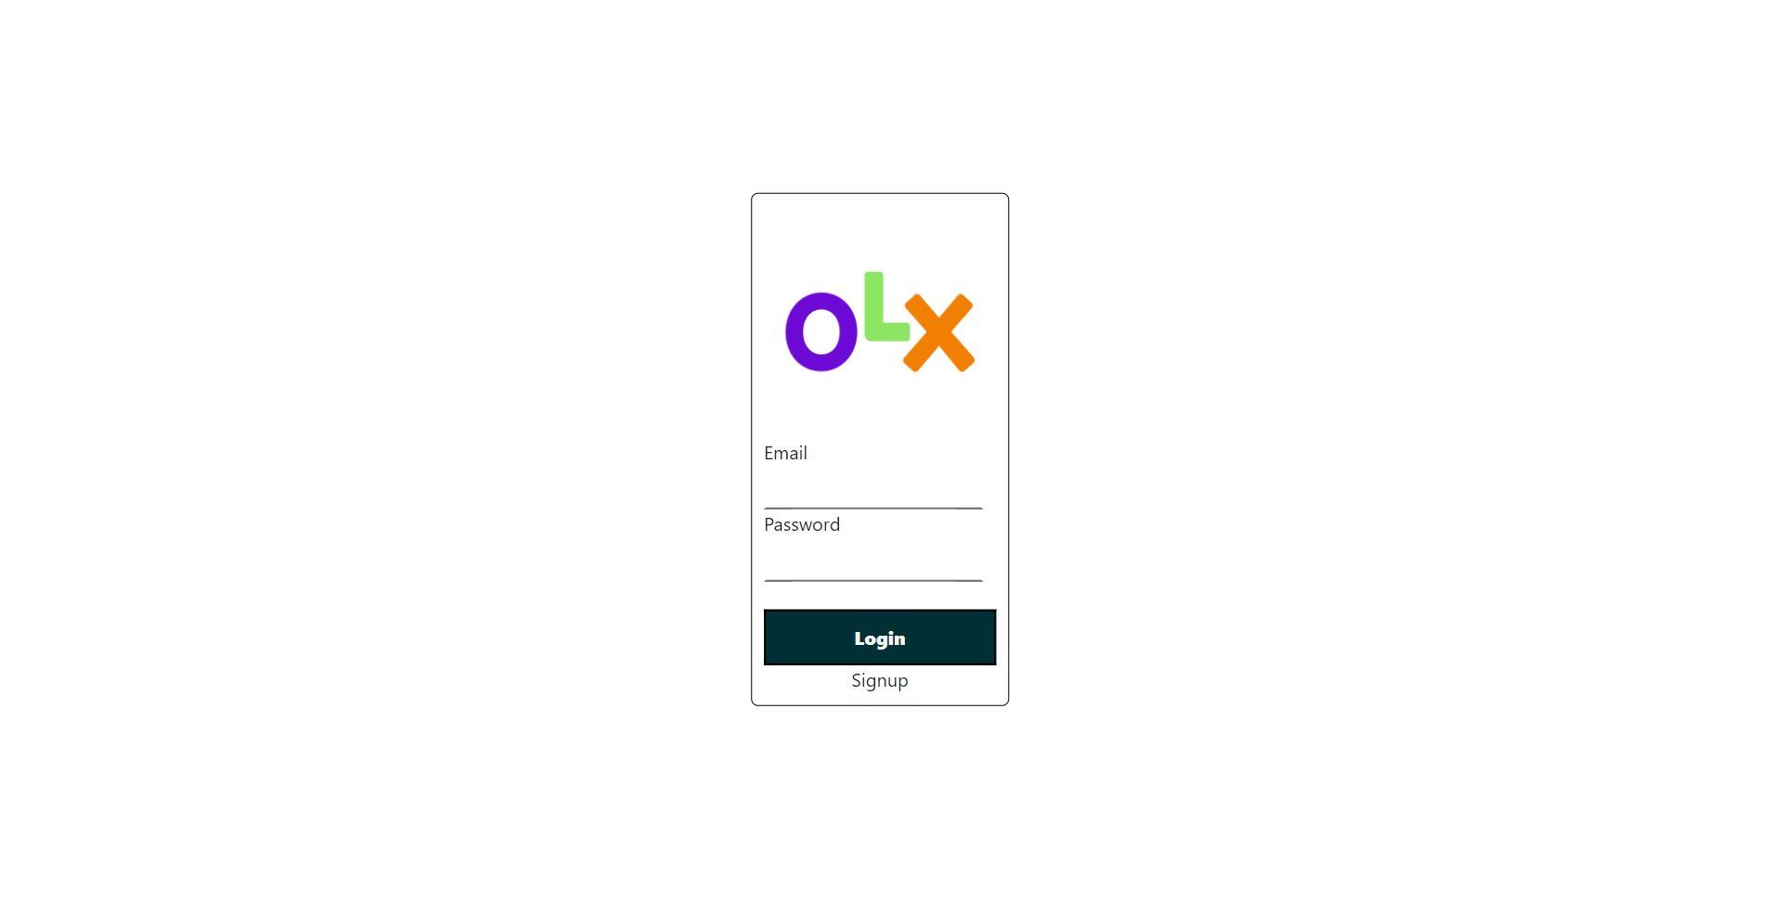
I have done all this work in Login.js file in which first of all I have created div with className = “LoginParentDiv” in which I have insert img and then I have created form tag with onSubmit={handleLogin} in which I have make label with name Email and so on. Then I have created input with onChange={(e) => setEmail(e.target.value) and same as for password. In the end I have created Login Button which will get updated because we have used handleLogin as upward. After this I have created SignUp button on which I have given link to the signup page by using onClick={handleSignUp}.

Slide 6
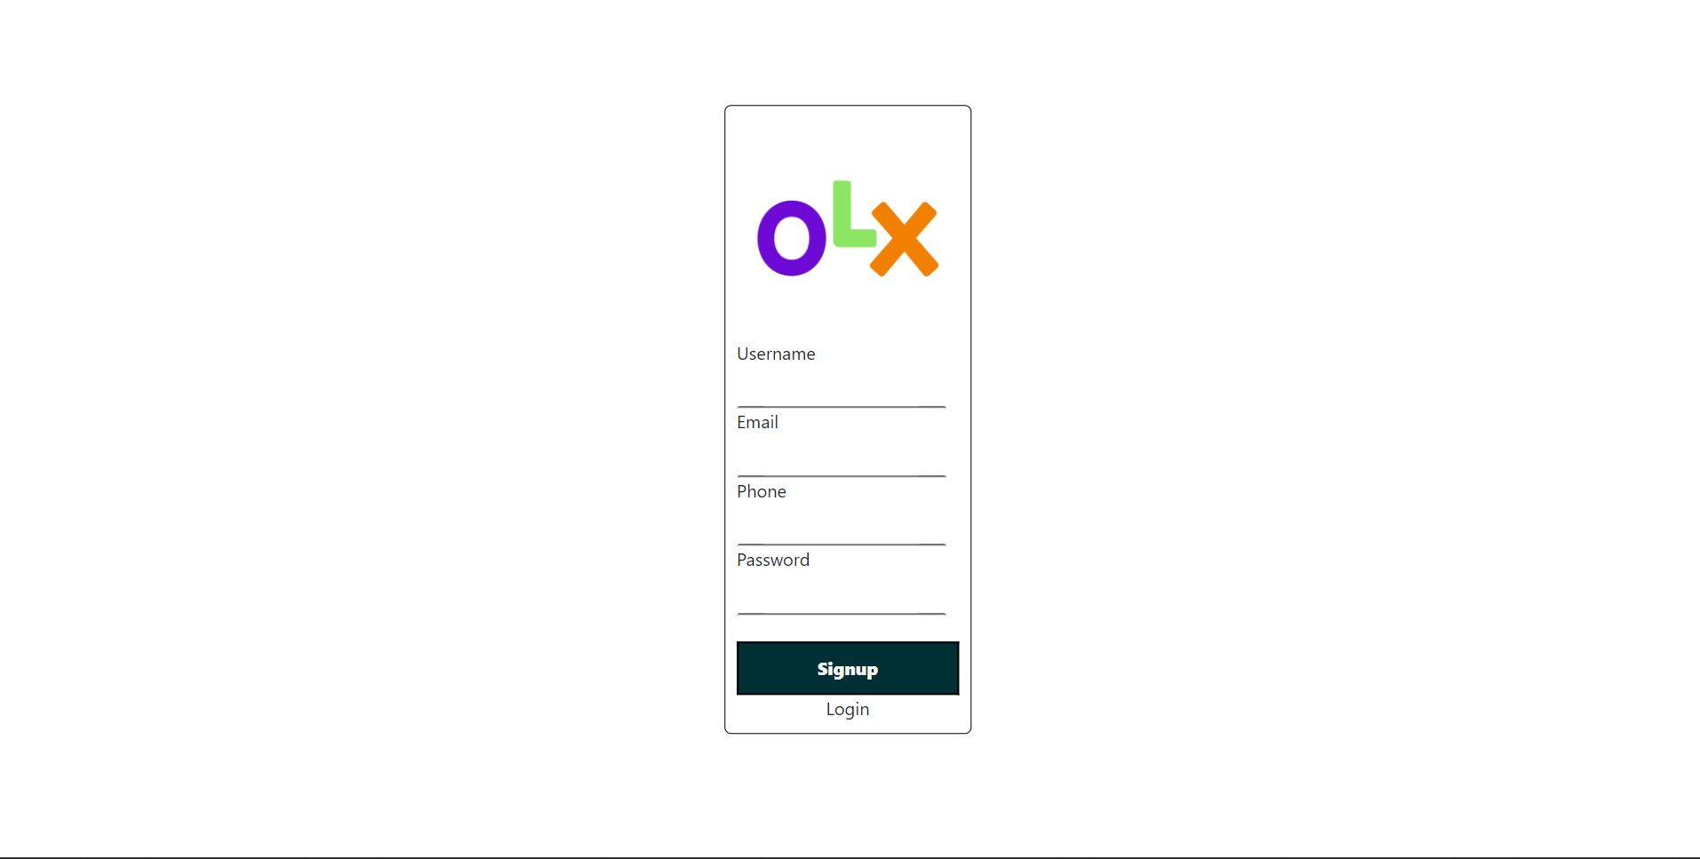
I have done all this work in SignUp.js file in which I have created a div with className = “signupParentDiv” in which I have inserted img and Later on I have created form tag in which I have created onSubmit tag in which I have given the handleSubmit so that we can refresh it or submit it and next we have created a label in which I have the name of Username and next Email and Phone and Password and next to them I have given input.

Slide 7
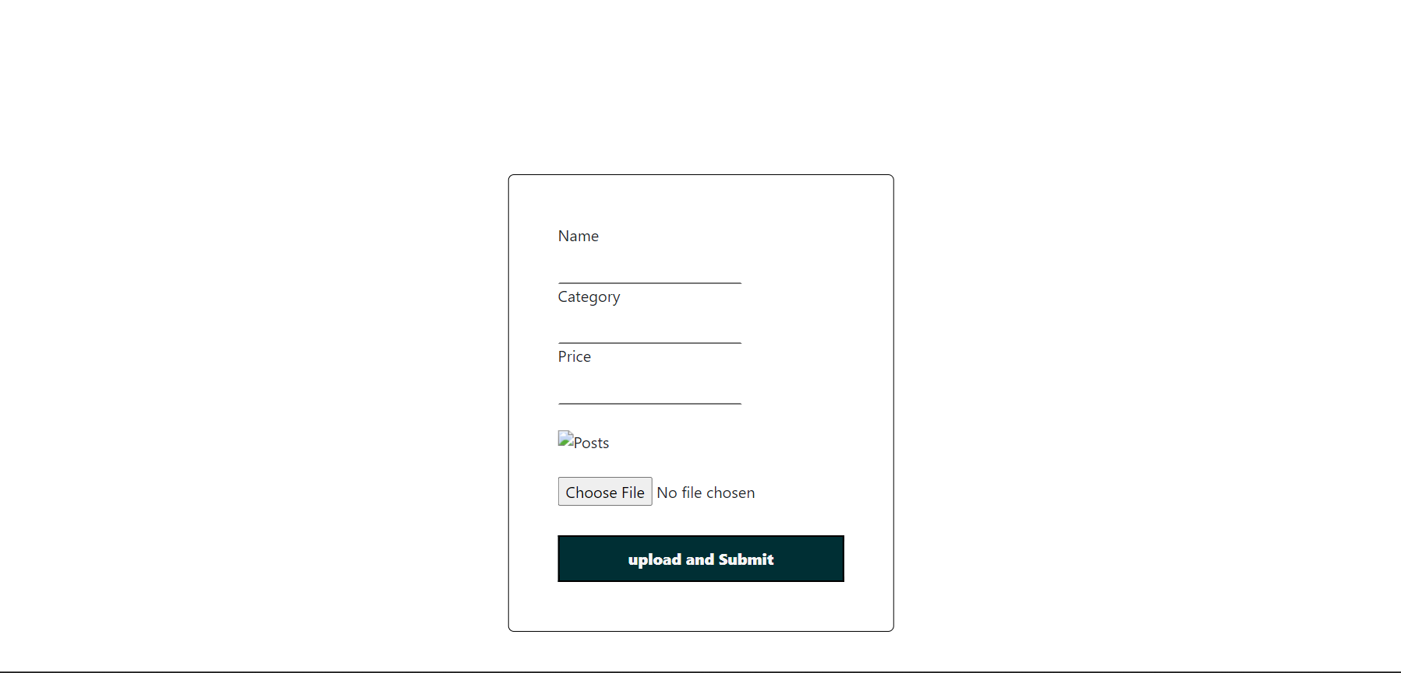
On Click to the SELL button using { handleSell }. In which I have created label Name Category and Price and Input and next time if I have created the input type=“file” .

Slide 8
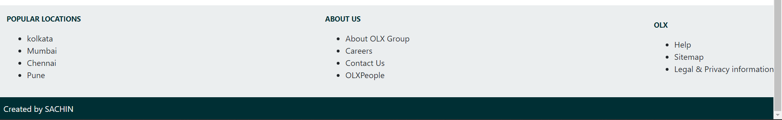
I have done all this work in Footer.js file in while I have created a div with className = “footerParentDiv” in which I have created another div with className = “content” in which I have created different div’s with in which I have created < ul > in which i have created < li > in which I have put different elements.

